Slide 1
EDN & PRT Data
EDN Conference
June 19, 2019

Slide 2
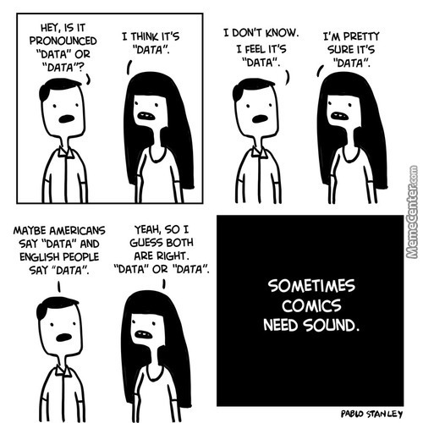

Slide 3
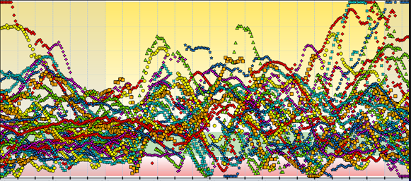
A day’s worth of NDE data

Slide 4
ILCD 3.0
PRT Annual Performance Reports
These are the 8 federal performance indicators required by OSEP.
Includes: Child Find data, child outcome data, family outcome data, transition data, settings and services data, etc.

Slide 5
ILCD 3.0
Determinations
Provided annually and largely based upon your local performance data.
PRT annual meetings and minutes go into determinations

Slide 7
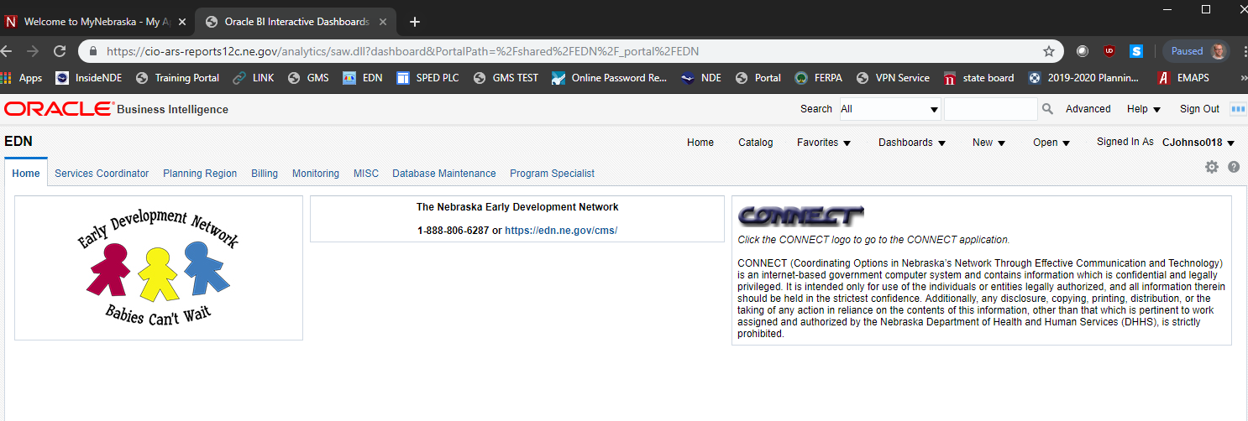
CONNECT Reports
THE NEW CONNECT Reports Dashboard

Slide 9
GOLD
Children who receive Part C services only need entry and exit documentation and finalized checkpoints.
Entry
Teachers/providers have 45-calendar days to complete documentation and finalize checkpoints within the checkpoint period in which the child’s entry date is listed.
Note: The initial GOLD assessment begins when the child is 6 months old.
Tools to support entry data:
Information provided from evaluation and assessment materials, such as: Routine Based Interview (RBI), DAYC results, summary of visit notes, parent input, etc.
Include ADVISER (previously NSSRS) # in GOLD profile

Slide 10
GOLD
Exit
Children receiving Part C services are to be exited from Part C on or before their third birthday.
In order to properly exit a child they must have documentation entered and checkpoints finalized before they turn 3 years old. The child’s data entered must fall in the checkpoint period in which the child’s exit date is listed.
How to exit a child for OSEP purposes: https://teachingstrategies.force.com/portal/s/article/How-do-I-exit-child-records-from-their-IEP-IFSP
After a child has been exited be sure to run your OSEP Federally Mandated Year End report to see if the child is listed. If the child exited is listed on the OSEP Federally Mandated Year End report, they have been properly exited.
How to generate the OSEP Federally Mandated Year End Report: https://teachingstrategies.force.com/portal/s/article/How-do-I-generate-the-OSEP-Federally-Mandated-Year-End-report

Slide 12
ADVISER (formerly NSSRS)
WHAT: a real time reporting system for districts to submit student level data including INFANTS and TODDLERS.
HOW: Districts must enroll eligible Part C EI infants and toddlers into their student information system (SIS). This SIS will then upload that data into ADVISER
WHY: This is how we gather data for our federal state child counts. Not entering Part C kids lowers PRT allocations and impacts the state’s federal and PRT child count data

Slide 13
ADVISER
Two important child count dates:
October 1 - This is a moment in time count where districts submit their child count--birth to 21--of kids who were enrolled and receiving services as of that date.
June 30 - This count is important for children exiting early intervention/special education, birth-21. For Part C, this is children ending services or transitioning to Part B services and this data is captured on this moment in time count.
Notes:
It is very important that Part C student data is entered into ADVISER at the district level to provide the Office of Special Education with the most accurate data in regards to child count, child settings, and services. Without Part C children in the system, the Department of Education can't track them and anticipate their transition to Part B services when applicable.

Slide 14
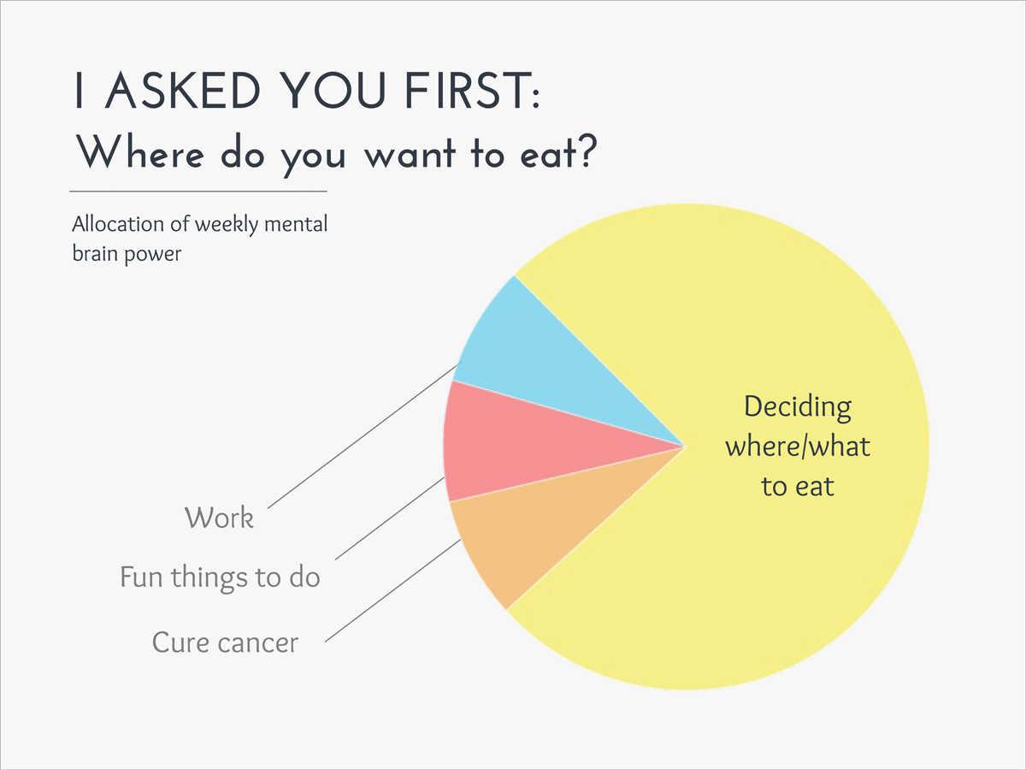

Slide 15
Putting it all Together
Data at PRT meetings
Moving beyond reporting just referrals and verifications. This is good for Child Find efforts but what is it doing for improved outcomes?
Possible additions:
Using CONNECT data to alert districts about ADVISER and GOLD entry
Using ILCD performance report data
Discussing current monitoring data and CAP progress, if
applicable
Tracking fidelity and professional development needs

Slide 19
Thanks

