Slide 1

Results Driven Accountability
Stakeholder Meeting
2026
Jessica Anthony, Amy Bunnell, Cole Johnson
Ann Kavanaugh, Sheila Brodersen
Notes:
CL

Slide 2
Why Are We Here?
In 2014 U.S. Department of Education, Office of Special Education Programs (OSEP) added a new requirement for states to develop a State Systemic Improvement Plan to improve child and family outcomes for children/families in early intervention.
Notes:
Sheila

Slide 3
Routines Based
Early Intervention (RBEI)
Three Improvement Strategies:
Routines Based Interview (RBI)
Functional Outcomes
Quality Home Visits
Notes:
Sheila
Very brief overview for the families in the audience that may not know about RBEI.

Slide 4
Routines Based Interview (RBI)
The RBI is a semi-structured interview during which the family describes their day-to-day life in terms of their child and family’s function: what’s going well and what’s not.
Notes:
Sheila
1 Building relationships
2. To get a rich description of how the child and family function in daily routines
3. to identify outcomes that the family would like help with

Slide 5
IFSP Outcomes are based on:
Child participation within everyday routines (child outcomes)
Family perceived needs – housing, education, medical resources, etc. (family outcomes).
Notes:
Sheila
Highlight family perceived needs. The family outcomes address family needs that will allow them to be in a better position to meet the needs of their child.
refer to our mission statement:
We’re always going to work with families to build their capacity to meet their own child’s needs and support their child’s learning, so we don’t need to write a goal for them to “have strategies” to help develop a skill.

Slide 6
Routines-Based Home Visits
  The Getting Ready (GR) Approach is focused on enhancing child outcomes by strengthening engagement between, and building competencies within:
  parent-child interactions
  parent-early intervention professionals
Notes:
Sheila:
The Approach is a child and parent-focused intervention focused on improving child outcomes. Key components include: 1) strengthening relationships between parent and child, and parent and professional; and 2) building parent competencies for enhancing parent-child interactions.

Slide 7
RBEI Updates
What’s New
Accomplishments
In the Works
Notes:
Sheila

Slide 8
2026-27 What’s New

Slide 9
Nebraska’s RBEI Infrastructure
EDN
Co-Leads
4 RBEI
State Coordinators;
9 Regional TA Providers
State RBEI Coach Cadre
PRT Chairs and Lead Agencies
PRT Leadership Teams
PRT Internal Coaches
EI Providers and Services Coordinators
Notes:
Sheila:
Highlight the change in our structure. Sue and Janice have backed down their support to the state coach level.
List the 4 RBEI State Coordinators and what our roles are:
Tina - Lead Coordinator and GR Facilitator
Ann - RBI Facilitator
Andrea - Coach Training Facilitator
Sheila - Outcomes Quality Facilitator

Slide 10
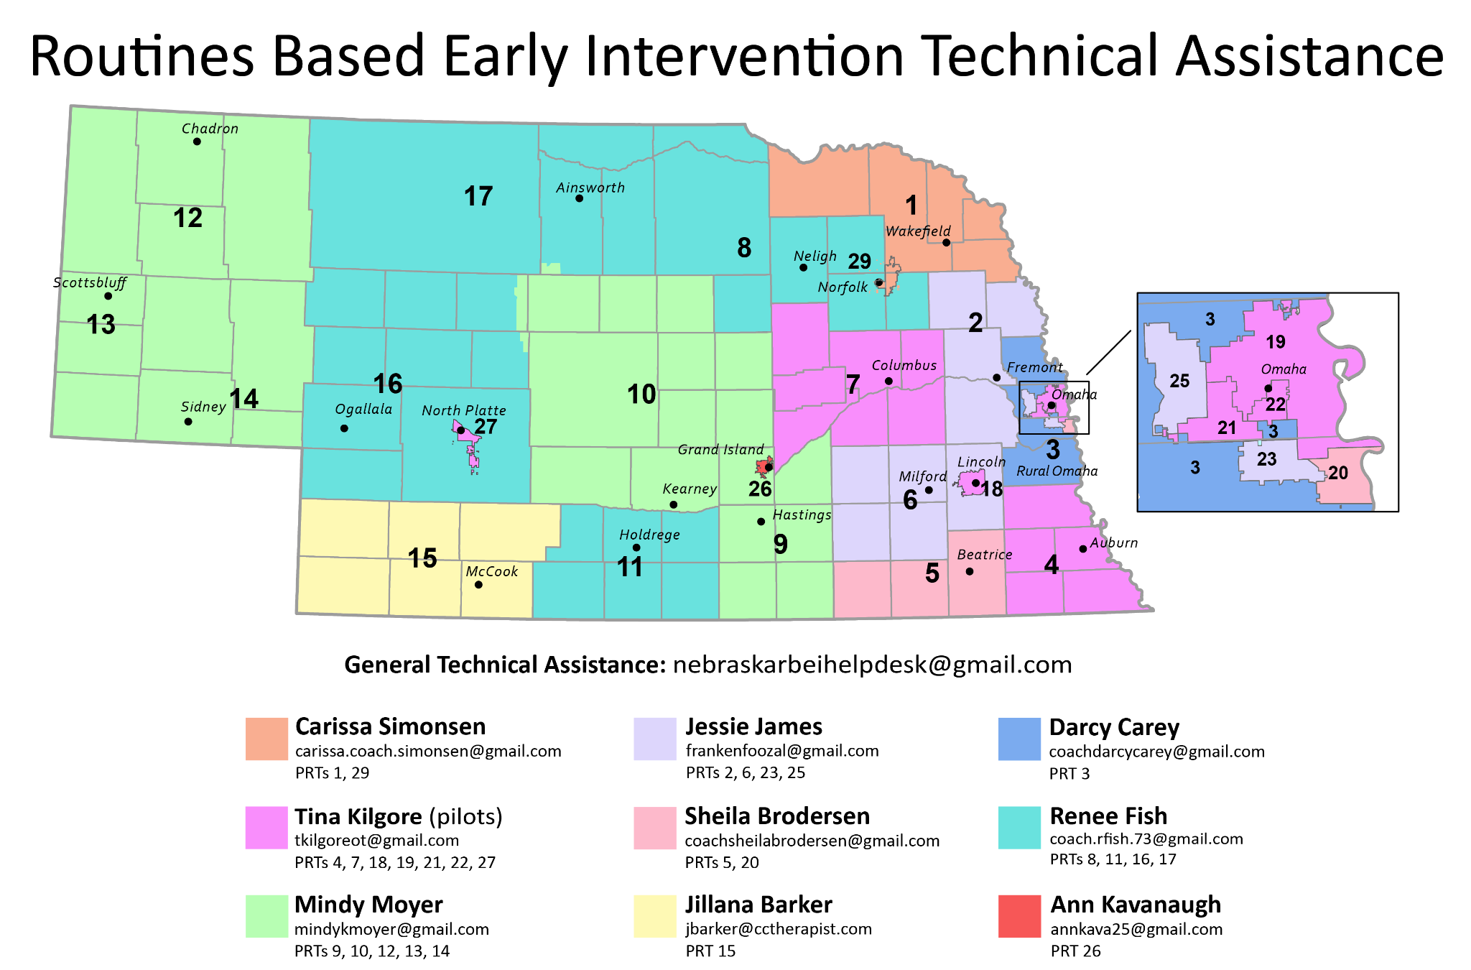
Notes:
Sheila
Highlight the General Technical Assistance email - nebraskarbeihelpdesk@gmail.com as an easy way to reach out if they have a question that they are not sure where to direct it.
27 Planning Region Teams Some Rural Some Urban Some multi-district some single district

Slide 11
2025-26 Accomplishments

Slide 12
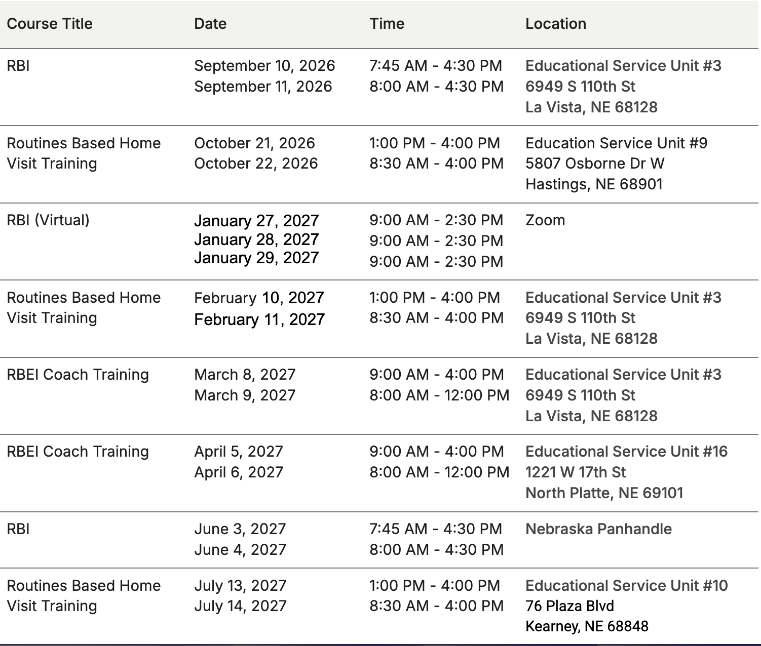
RBEI Statewide Training Calendar
Notes:
Ann
-All 3 strategies have been trained throughout the state
-Systematized training schedule blend of in person and zoom and around the state
-Sustainable annual training plan

Slide 13


Collaborations!
https://asdnetwork.unl.edu/
https://atp.nebraska.gov/education
Notes:
Ann
Collaboration with RBEI TA, ASD Network, and ATP - purpose was so that when those groups are talking about their evidence-based practices - it aligns with our strategies (RBI, GR, outcomes).

Slide 14

Enhancing Early Autism Support
Through Routines Based Early Intervention
Jamie Lewis, Mikki Bohling, & Tina Kilgore
https://asdnetwork.unl.edu/enhancing-early-autism-support-through-routinesbased-early-intervention/
Notes:
Ann Webinar on the website.
Transition to Lisa for next slide.

Slide 15


Follow-Up Coaching
Supporting Evidence-Based Practice
Notes:
Lisa

Slide 16
RBEI Coaching Definitions
Enhanced coaching - designates a coaching process that extends beyond completion of a checklist.
Internal coaches - early intervention providers and services coordinators who coach other professionals in their local PRT to implement RBI’s, quality IFSP outcomes, and routines-based (GR) home visits.
Follow-Up coaches - state coaches who support internal coaches in using the enhanced coaching process and tools in their local PRT.
Notes:
Remind the audience what RBEI stands for; brief description of what a checklist might be used for (RBI, GR HV) and how its different from enhanced coaching (i.e. telling what is right and wrong vs driven by the request or PD needs of the provider/SC and starting with strengths, prompting reflection, sharing information; and collaborating about next steps.

Slide 17
Sue Bainter - State Coach
Why Follow-Up Coaching?

Slide 18
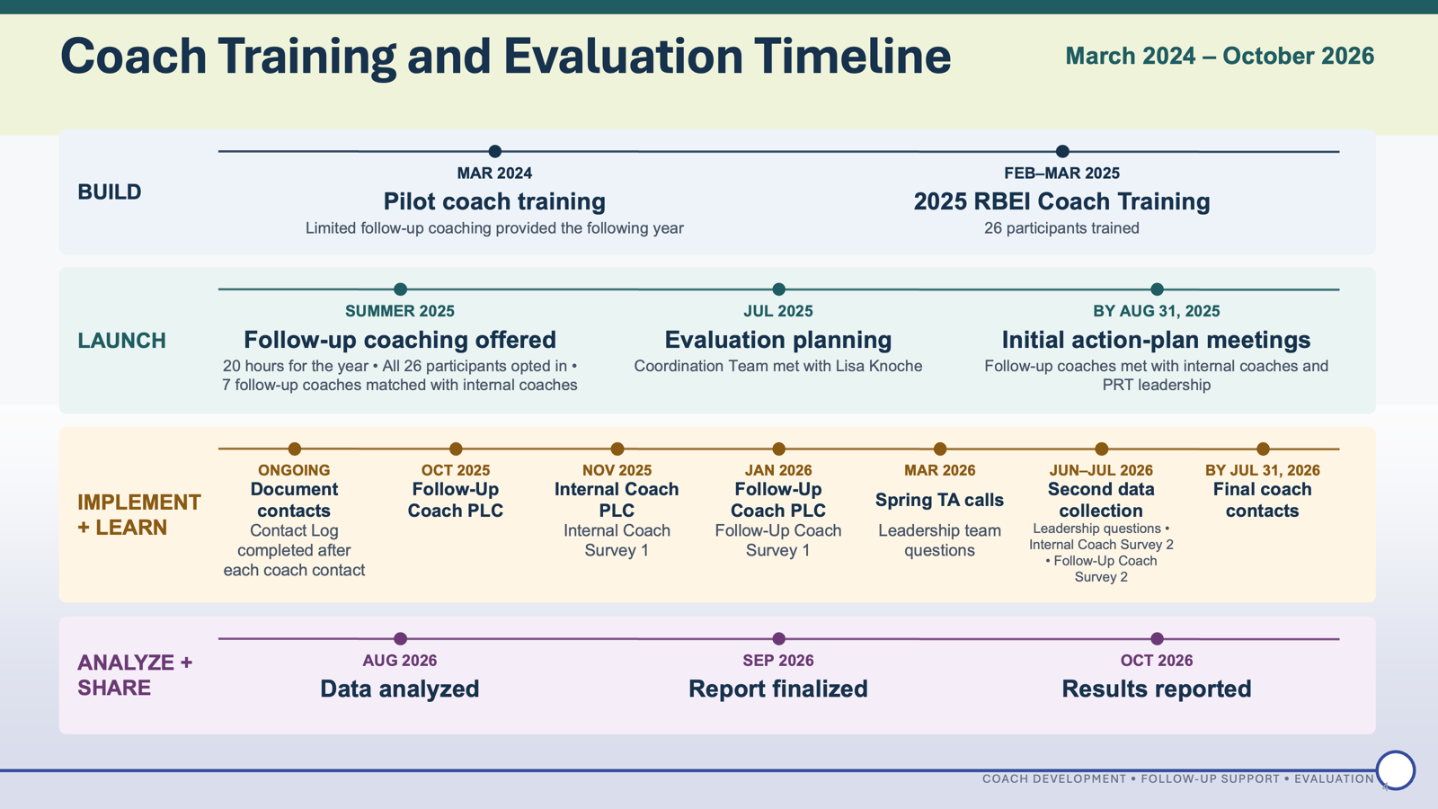

Slide 19
What did we learn?
Follow-Up Coaching.....
Built Confidence
Supported Competence & Growth
Provided Value and Sustainability

Slide 20
Follow-Up Coaching....
Built Confidence

Slide 21
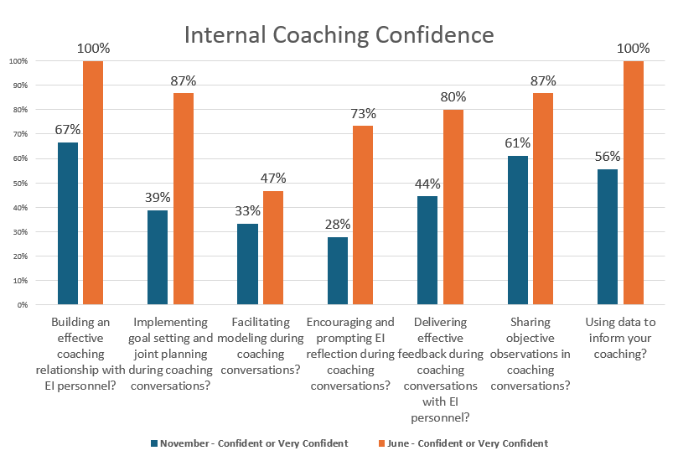
Gains in confidence from November to June were substantial.

Slide 22
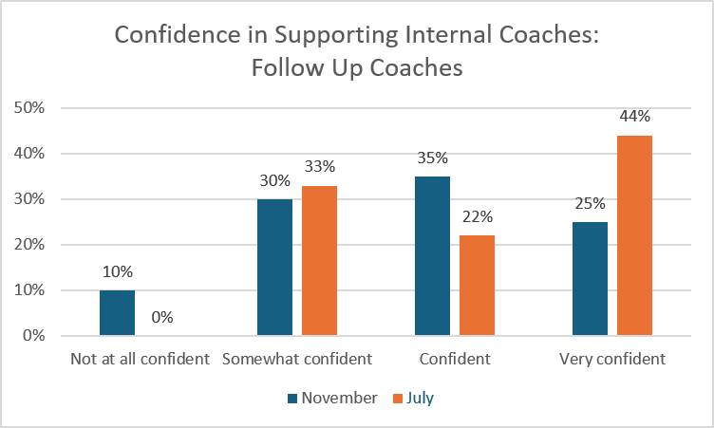
By July nearly 66% of Follow-Up coaches felt confident or very confident in their work supporting internal

Slide 23
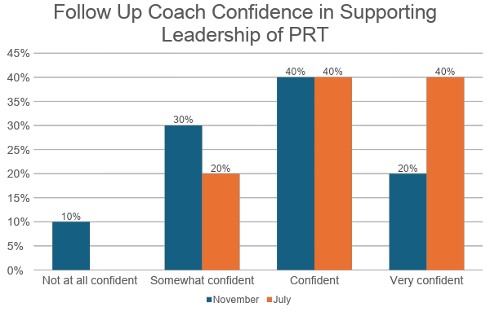
By July nearly 80%of Follow Up coaches were confident or very confident in their support of PRT leadership

Slide 24
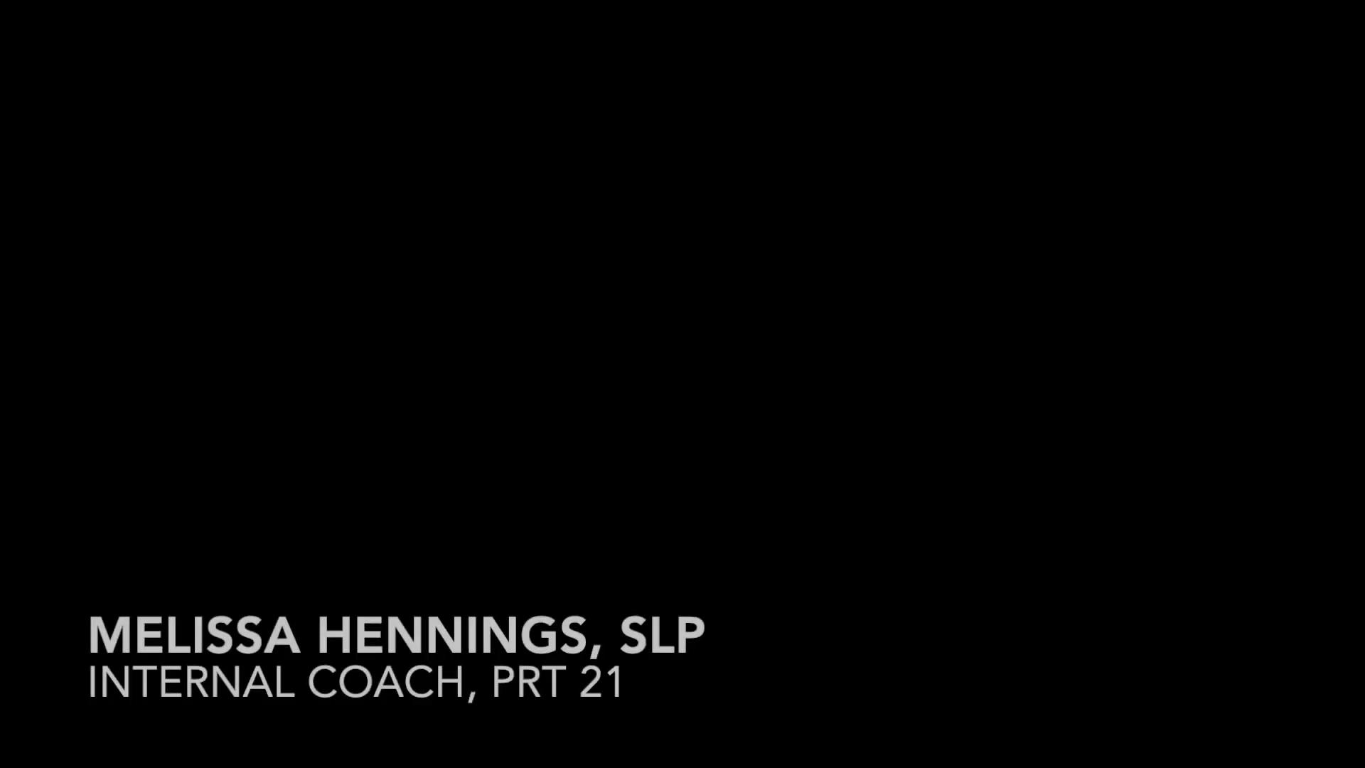
Internal Coach - Provider

Slide 25

Internal Coach - Services Coordinator

Slide 26
Follow-Up Coaching....
Supported Competence & Growth

Slide 27
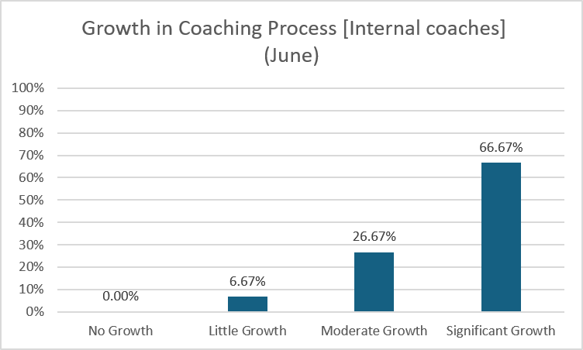
Internal coaches reported personal growth in their use of the enhanced coaching process when assessed in June.
Since training, 2/3 of Internal coaches reported significant growth by June with another 26.67% expressing moderate growth.

Slide 28
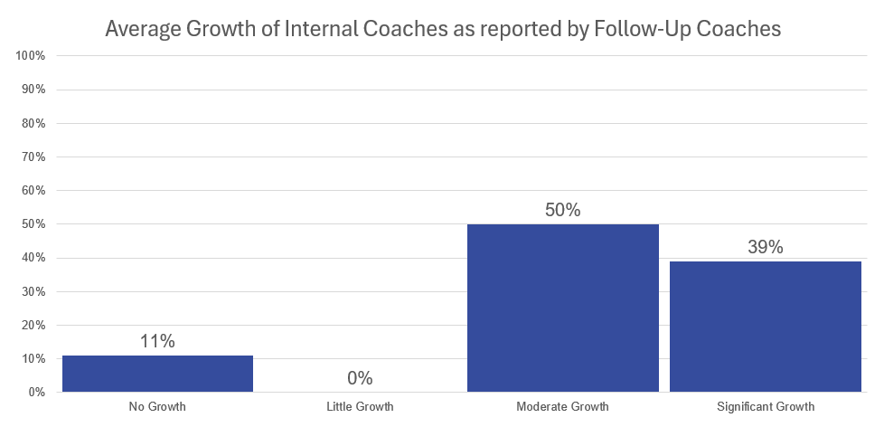
Almost 89% of internal coaches were assessed to have moderate or significant growth.

Slide 29

Follow-Up Coach

Slide 30
Follow-Up Coaching....
Provided Value and Sustainability

Slide 31
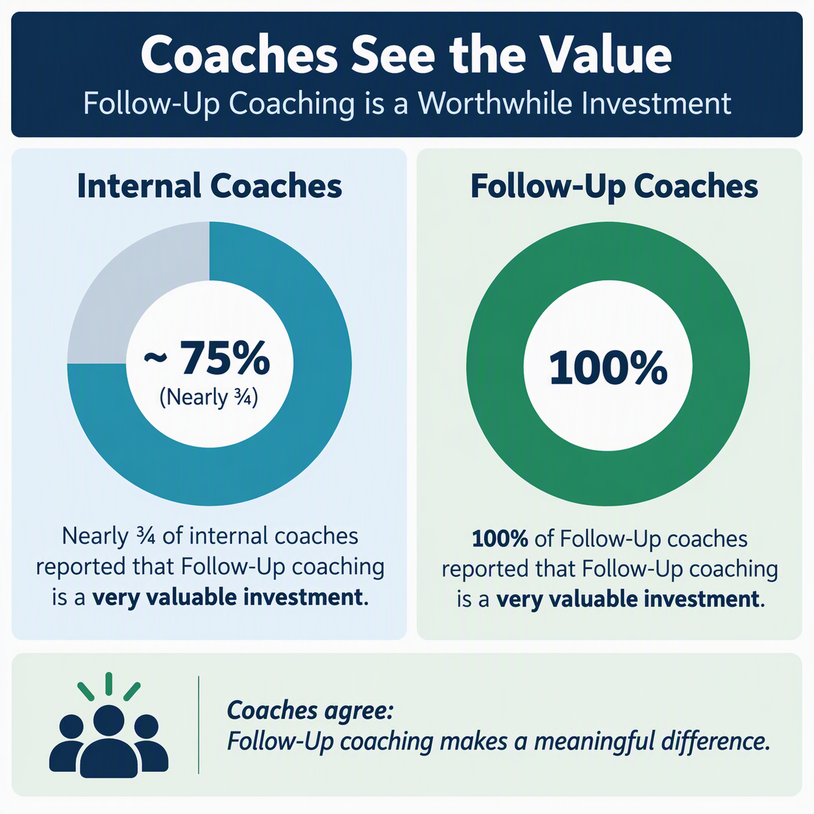

Slide 32
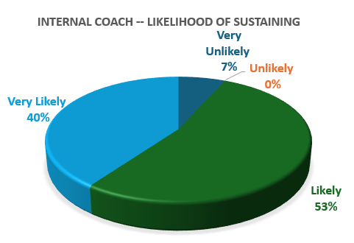
93% of Internal coaches indicated it is “very likely” or “likely” that their PRT will sustain the gains made toward enhanced coaching.
Follow-Up coaches also rated PRTs as having a high commitment to supporting enhanced coaching and indicated they would be likely (70% of PRTs) to very likely (30% of PRTs) to sustain gains made.

Slide 33

PRT Leadership

Slide 34
Follow-Up Coaching....
Facilitators and Barriers

Slide 35
Supports that helped coaches…..
PLCs
Collaboration with other internal coaches from other regions
Positive relationships
Supportive/committed local leadership team
Individual access to follow up coaches
Communications and information sharing
Adequate time and resources
Structures/tools/resources that contribute to promoting reflection
Getting feedback
Coach portal, tools and PLCs (follow-up coaches)

Slide 36
Challenges and barriers reported…..
Need to already have some kind of a fidelity process in place
Limited time to participate in the activities that were part of "follow up coaching"
Limited time to coach
Financial resources, staffing, capacity
  Balancing coaching responsibilities with existing job duties and caseloads
Buy-In, resistance, and provider/coach engagement
  Difficulties with provider participation, commitment, or acceptance of the coaching process.

Slide 37
Take Aways…

Slide 38
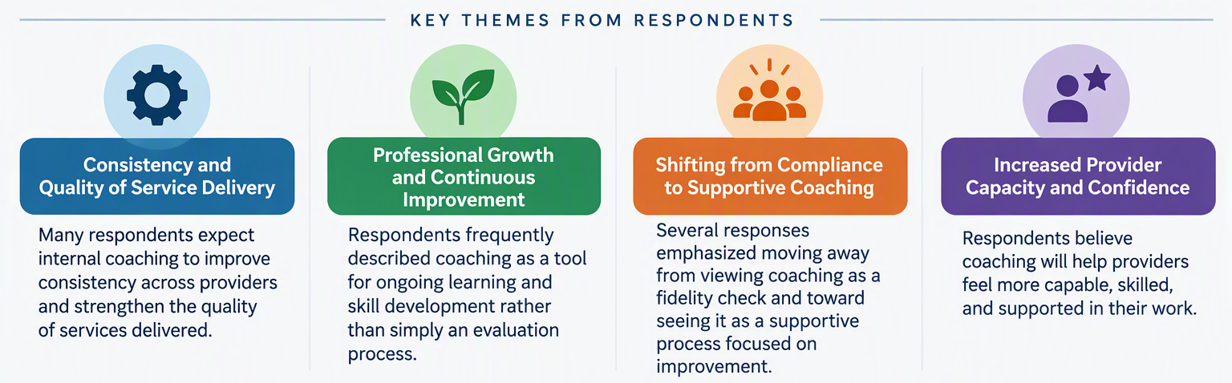
What will be the impact of the enhanced coaching process on your region's fidelity process and/or on child and family outcomes?

Slide 39
Feedback From The Field
Notes:
Lisa transition to Ann

Slide 40
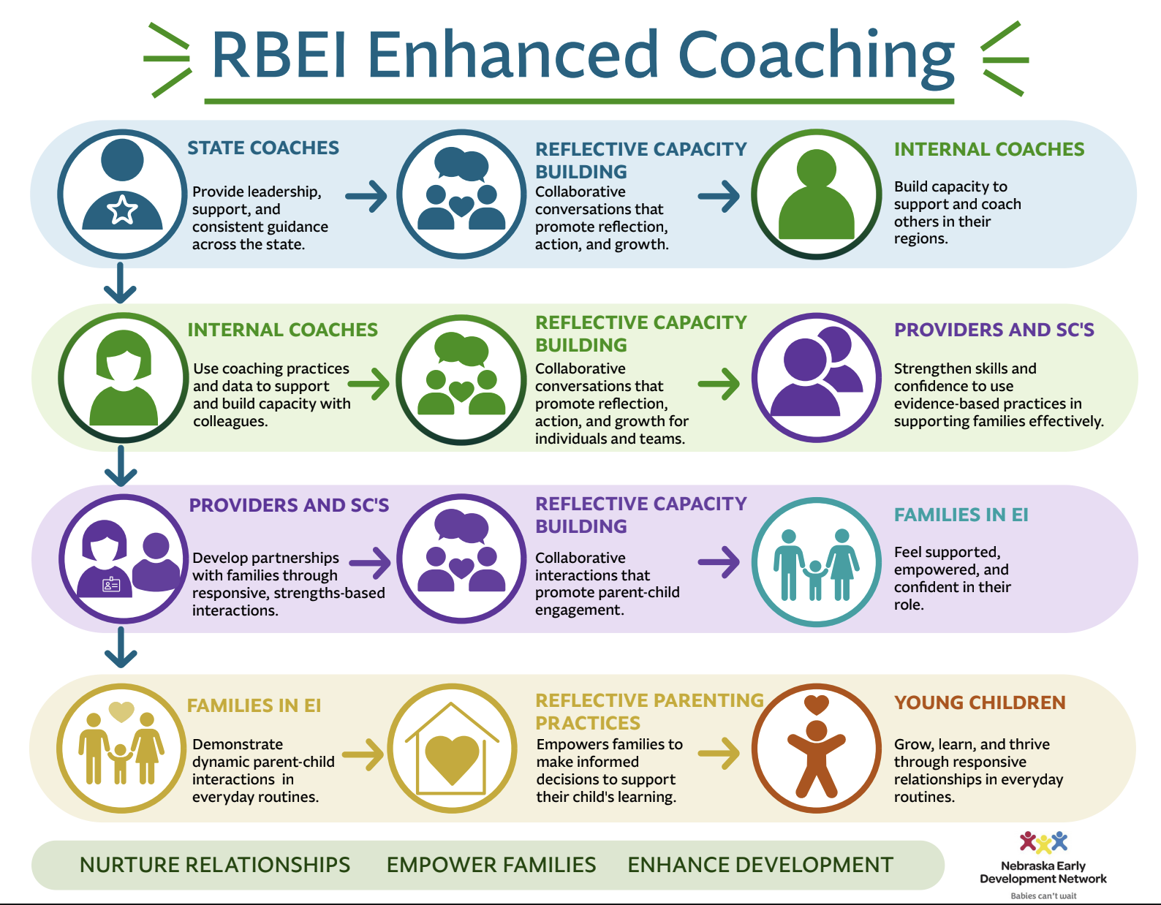
Notes:
Ann - Make connection to the upcoming videos.
This visual really helps us see the bigger picture of the Enhanced Coaching Process. We know that the idea of a fidelity check can sometimes feel a little intimidating. But when we shift our thinking and see the fidelity checklist as a way to gather information that supports continuous improvement, it takes on a very different purpose.
What I really want to highlight here is the parallel process happening across each level. At every level, we’re using reflective, capacity-building practices grounded in evidence. Coaches use those practices with providers, providers use them with families, and ultimately, families use those same kinds of reflective practices as they support their children.
That’s where the impact really comes together. Our goal isn’t simply fidelity. Our goal is to build competence and confidence throughout the entire system, so that families feel more confident and capable in supporting their children’s learning and development.

Slide 41
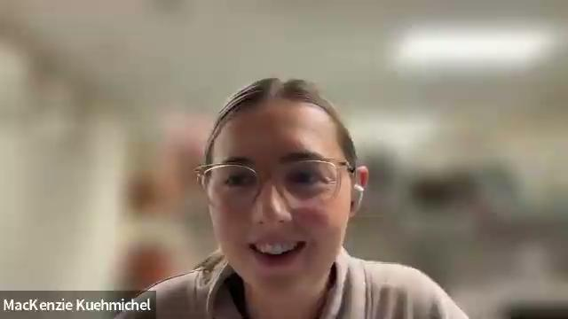
Notes:
Reflect:
How did this differ from other experiences with feedback
What impact do you see coaching having on you and your team.
What impact has enhanced coaching had on the families you serve?

Slide 42

Notes:
Ann 1:02

Slide 43
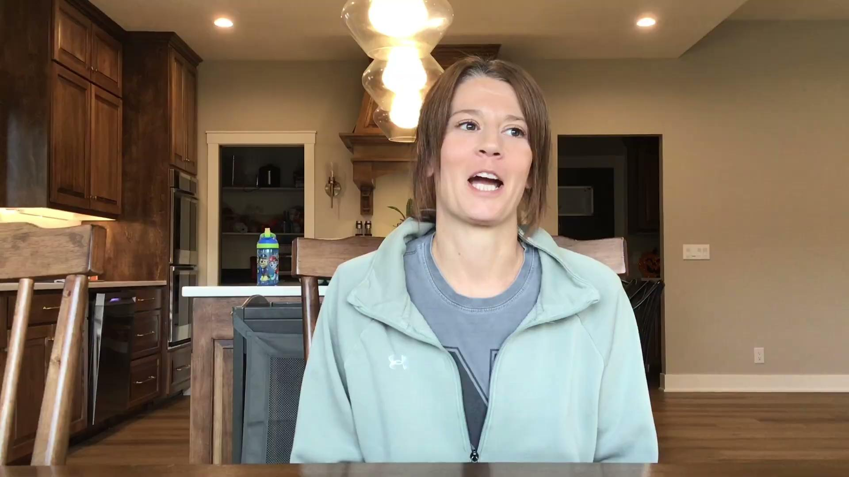
Notes:
Ann

Slide 44
2 Minute Pause for Reflection
Reflecting on your experience as a family member, provider, services coordinator, internal coach, and/or PRT leadership, how does what you saw in the video clips compare to your experience? What would you like to see as a next step in your region?
Turn & Share With a Neighbor
Notes:
Highlight the registration for RBEI Coach Training - due November 15th.

Slide 45
Annual IFSP Outcome Analysis
IFSPs from Cohort Planning Region Teams are analyzed for quality and quantity of outcomes (i.e. do they have routines, are they measurable etc.).
Notes:
Sheila
Say the words Individual Family Services Plan

Slide 46
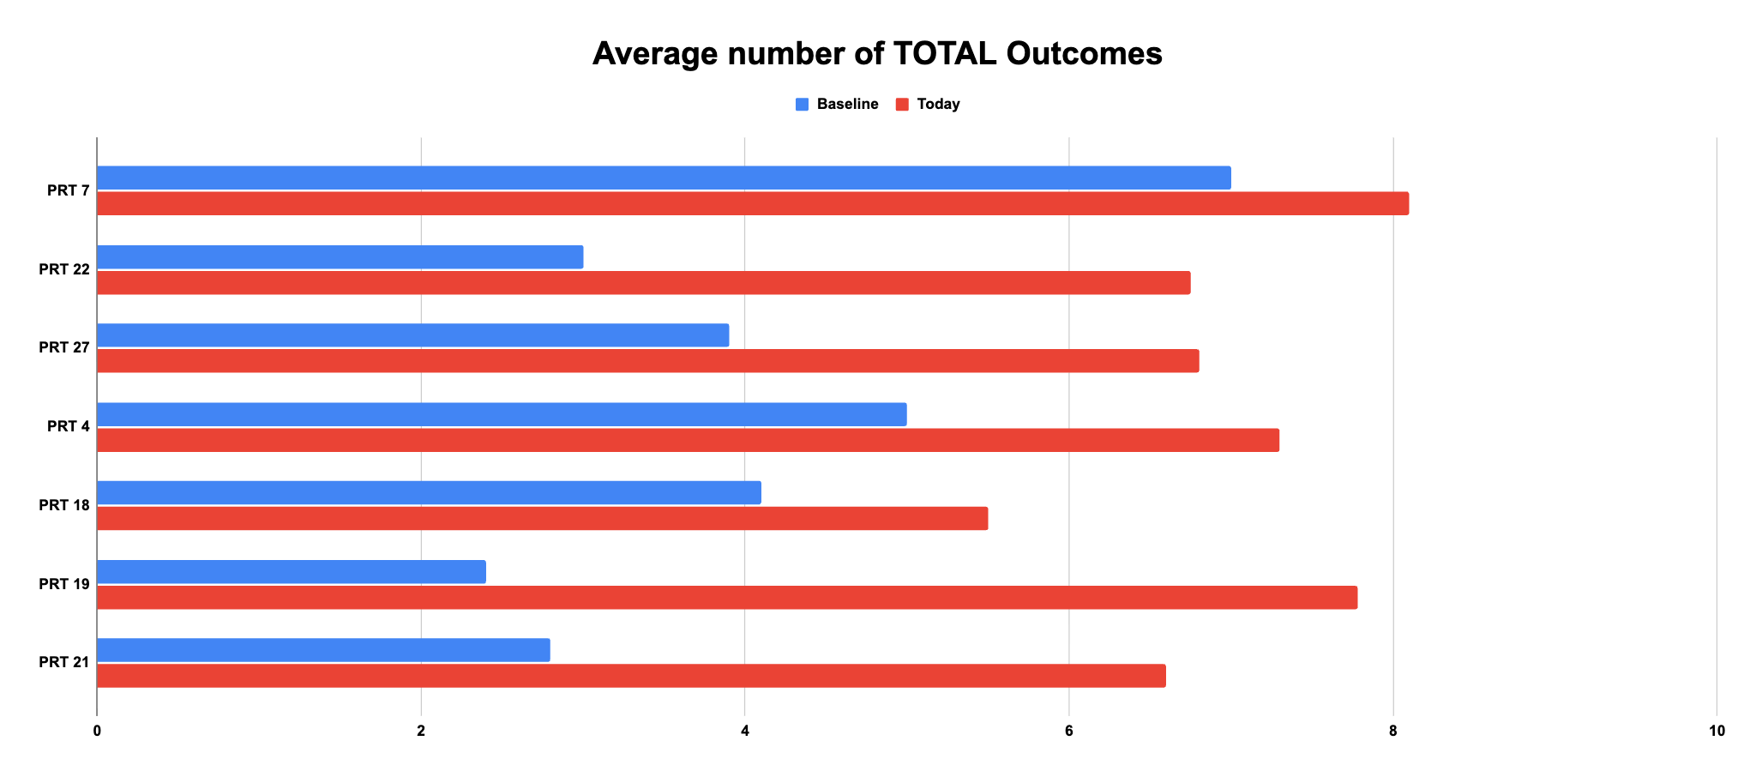
Notes:
Sheila
What was exciting to see was an overall increase in total number of outcomes across all Pilot regions. Like we say at the end of the RBI while making the priority list and everyone hears in the RBI training, research shows that 6-12 outcome are some of the best plans. We are certainly making amazing gains towards that expectation.
Add city area or cohorts slide

Slide 47
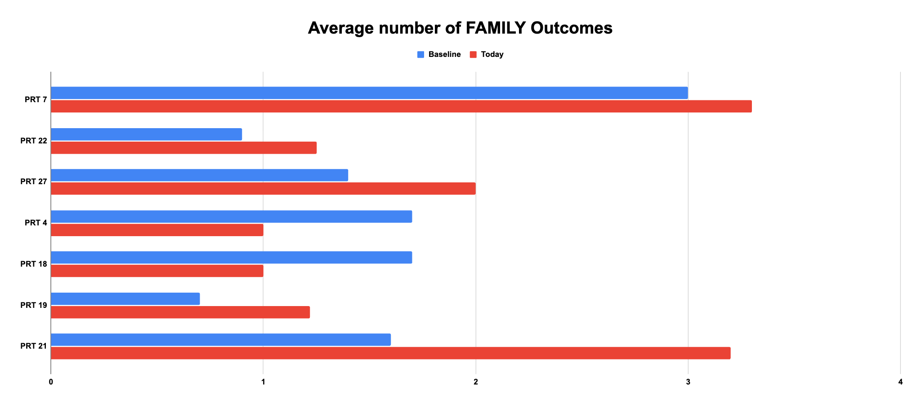
Notes:
Sheila
Even though it is not required to have a Family Outcome on a plan, you can see that the averages are still showing that teams are listening the families and what they would like to work on that is beyond the identified child’s concern.
Overall, in this data set, outcomes had specific action steps that a parent was going to take with a specific due date.
For the ones that show a decrease it isn’t a negative, we want to see that there are Family outcomes getting on plans. There is no minimum or max number of Family outcomes.

Slide 48
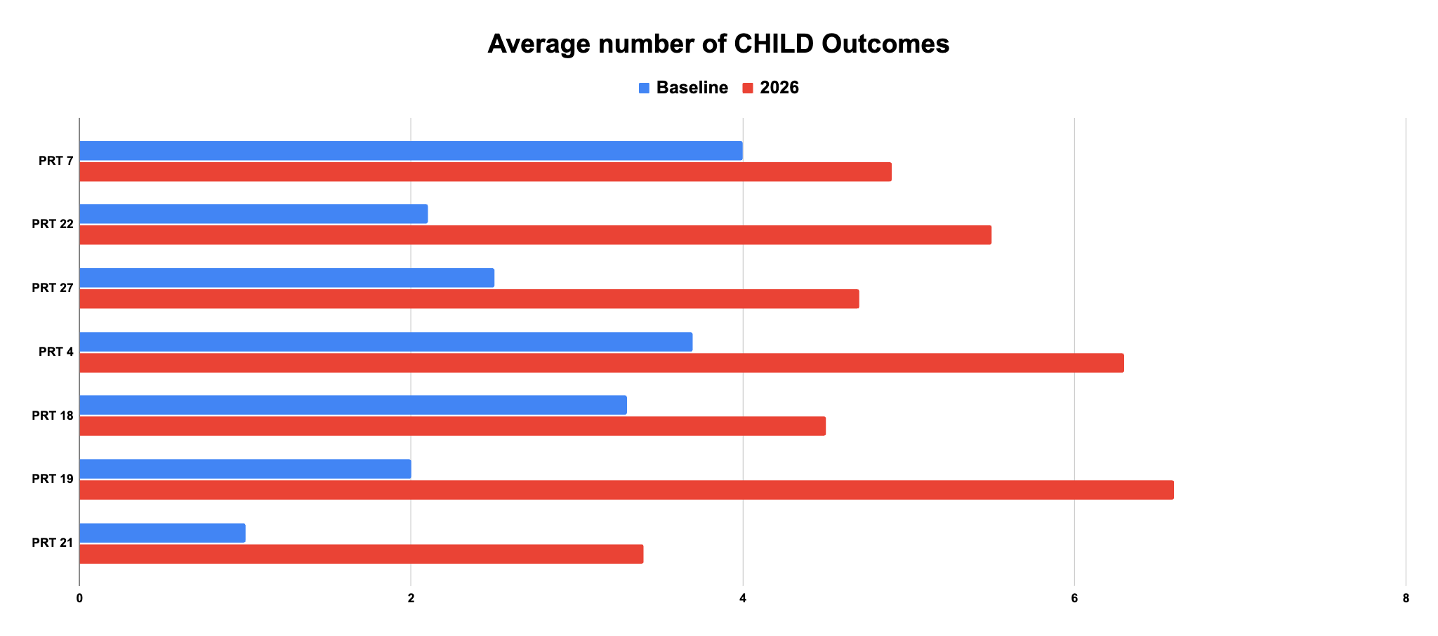
Notes:
Sheila
Look at these increases of child outcomes! This is something to celebrate.

Slide 49
Trends from 2026
1. Total Outcomes: Trending up!
2. Family Outcomes: How can we improve?
3. Child Outcomes: Connection between quality score and child progress.
Notes:
As we looked at the quality of outcomes we found these trends:
1. Thinking about how priorities become outcomes are key. From thinking about the next step in the child’s development to breaking down larger priorities indicated by a family (i.e., want the child to talk, want the child to play) have and can continue to be factors in building up total outcomes.
2. What is tricky about a family outcome, is that a Parent may have a priority that says “I would like ideas on how to get my child to talk” or “I need ideas for potty training”. Even though that may sound like a Family Outcome because it is a parent indicating something they want to do, it is directly related to a child skill.
3. There was a notable difference in how some child outcomes are being written —more specific routines and some with functional skills (i.e., use a word to get a toy they want so they can take turns with a sibling OR sits independently to play with a toy”). However, there was a trend of having multiple skills being listed, lengthy measurement, and nonfunctional child skills (i.e. “to be more independent”).

Slide 50
2 Minute Pause for Reflection
Keeping in mind that the data we collect is based on the pilot regions, how could you learn about how your region’s data compares to this data? What next steps might you consider for improvement in your area?
If you are a family member, how do you feel like this data compares to your child’s IFSP outcomes? Based on this data, how might you want to think about future IFSP outcomes?
Turn & Share With a Neighbor

Slide 51

Questions
Notes:
Sheila Where can we put in some questions from the audience.

Slide 52
Thank You
nebraskarbeihelpdesk@gmail.com
Tina Kilgore tkilgoreot@gmail.com
Andrea Nelson coachandreanelson@gmail.com
Sheila Brodersen coachsheilabrodersen@gmail.com
Ann Kavanaugh annkava25@gmail.com
Notes:
Question slide
Thank you with Coordinators info to contact

Slide 53
EDN Co-Lead Updates

Slide 54
IDEA Part C Annual Performance Report (APR)
Federally required report submitted to the U.S. Department of Education, Office of Special Education Programs on Feb. 1, 2026.
The annual report contains required information and data for the reporting period of July 1, 2024 to June 30, 2025.
Notes:
Amy

Slide 55
Federal Determination
Based upon the State’s Annual Performance Report (APR) data submission:
Meets Requirements and purposes of IDEA Part C
Needs Assistance in implementing the requirements of IDEA
Part C
Needs Intervention
Needs Substantial Intervention
Notes:
Amy

Slide 56
Federal Determination
2 data sets used to calculate Determinations
•Compliance Data
•Child Outcome Data
Compliance Data=100%
•Timely IFSP Services 99.06%
•IFSP’s in 45 days 96.23%
•Transition
•8A (Transition plan 90 days prior) 94.87%
•8B (Transition Notification to District) 100%
•8C (Transition Conference 90 days prior) 94.87%
Earned 16 out of 16 possible points= 100.00%
Notes:
Amy

Slide 57
Federal Determination
Early Childhood Outcomes
3A. Positive social-emotional skills
•Substantial growth: 59.8%/56.74%
•Age expectations: 51.84%/44.32%
3B. Knowledge and Skills
•Substantial growth: 59.08%/58.16%
•Age Expectations: 42.10%/38.71%
3C. Use of appropriate behavior to meet needs
•Substantial growth: 58.39%/57.59%
•Age expectations: 51.74%/48.08%
Notes:
Amy
Summary Statement 1:
percent of infants and toddlers who substantially increased their rate of growth by the time they turned 3 years of age or exited the program.
Summary Statement 2:
percent of infants and toddlers who were functioning within age expectations by the time they turned 3 years of age or exited the program.

Slide 58
Federal Determination
Early Childhood Outcomes
•Data Completeness (2 out of 2 points)
•Data Anomalies (2 out of 2 points)
•Comparison to Other States (1 out of 2 points)
•Comparison to FFY 2023 Data for Nebraska (1 out of 2 points)
Earned 6 out of 8 possible points= 75%
Notes:
Amy

Slide 59
Federal Determination
Meets Requirements
Results Score/Compliance Score:
75/100=87.50%
Meets Requirements=80%-100%
Nebraska’s APR is available at: http://edn.ne.gov/cms/annual-performance-reports-apr
Report on the annual performance of Planning Region Teams on the APR targets at: http://edn.ne.gov/cms/regional-public-reporting-tables
Notes:
Amy

Slide 60

Child and Family Outcomes
Notes:
Jess

Slide 61
Family Outcomes
States are federally required to report annually on the percent of families participating in early intervention who report that they:
1) know their rights;
2) effectively communicate their children’s needs; and
3) help their children develop and learn.
Data collected via Family survey distributed by EDN services coordinators to every family participating in EDN.
Notes:
Jess

Slide 62
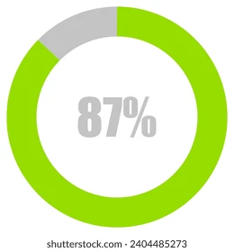
2026 Part C/EDN Family Survey Statewide Return Rate
Notes:
Jess-Average response rate across the 56 states and territories reporting: 33.30%

Slide 63

Notes:
Jess

Slide 64
Child Outcomes
Percent of infants and toddlers with IFSPs who demonstrate improved:
A. Positive social-emotional skills (including social relationships);
B. Acquisition and use of knowledge and skills (including early language/ communication); and
C. Use of appropriate behaviors to meet their needs
Notes:
Cole

Slide 65
Child Outcomes
Summary Statement 1:
percent of infants and toddlers who substantially increased their rate of growth by the time they turned 3 years of age or exited the program.
Summary Statement 2:
percent of infants and toddlers who were functioning within age expectations by the time they turned 3 years of age or exited the program.
Notes:
Cole

Slide 66

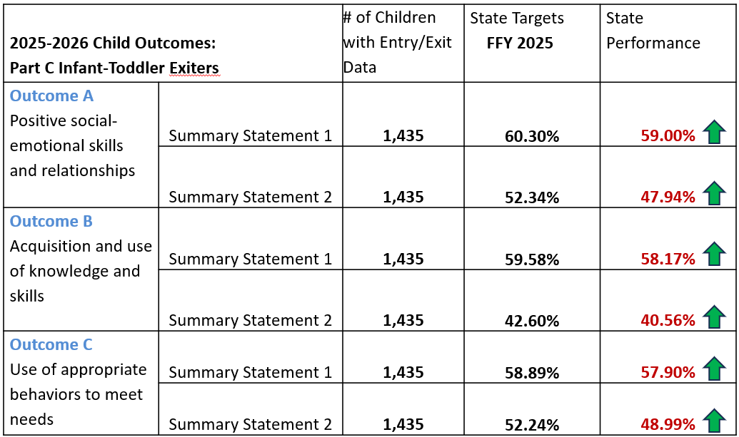

2025-26 Part C Child Outcomes Data

Slide 67
Frequency/Intensity of EI services
8 visits offered in 6 months
30 min per visit
5 visits actually occurring
Notes:
Cole
****Parent Questions*****
How many services they receive on average monthly basis - do you feel it’s enough to help support your family and child; do you think your child is making progress?
Where does your child receive the majority of his/her IFSP services? If at childcare, do you receive home visits too? How did the IFSP team decide where services will occur, i.e. who was involved in making the decision? What was the reason for choosing the location where the services occur?
If most of your child’s IFSP services are at childcare, do you know when the service is happening and what IFSP outcome[s] was addressed? If yes, how is this communicated with you? If no, how do you learn what is happening at childcare?

Slide 68
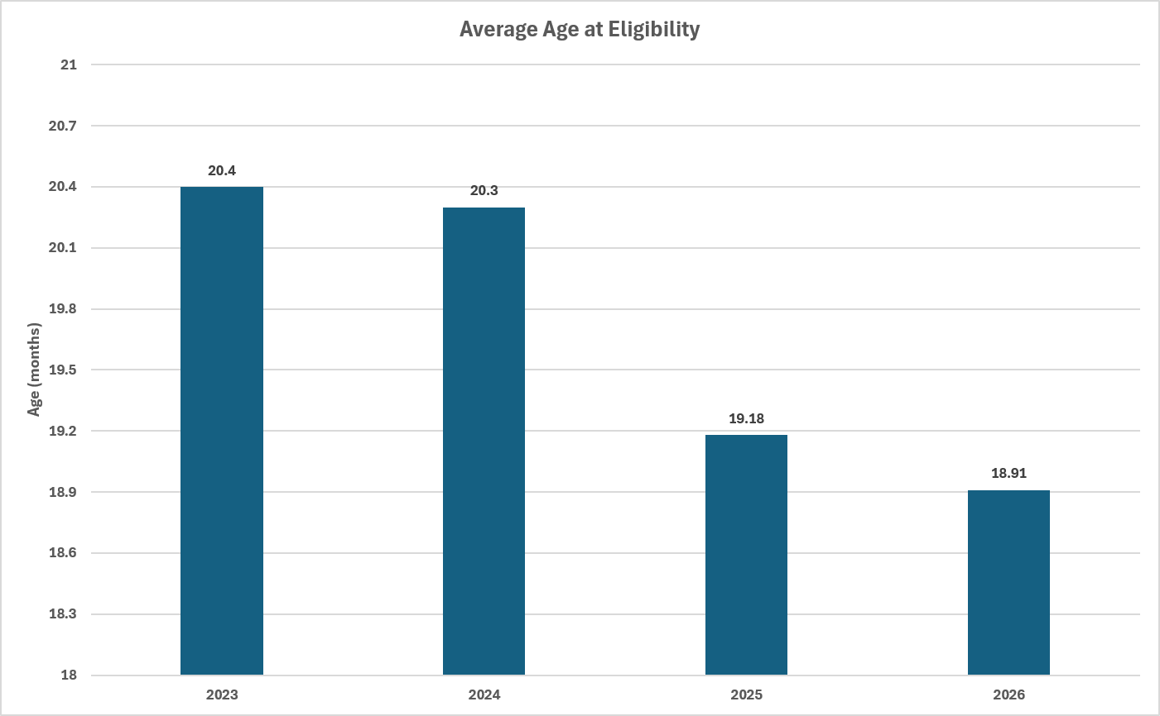
Child Find
Notes:
Cole
****Parent Questions*****
How many services they receive on average monthly basis - do you feel it’s enough to help support your family and child; do you think your child is making progress?
Where does your child receive the majority of his/her IFSP services? If at childcare, do you receive home visits too? How did the IFSP team decide where services will occur, i.e. who was involved in making the decision? What was the reason for choosing the location where the services occur?
If most of your child’s IFSP services are at childcare, do you know when the service is happening and what IFSP outcome[s] was addressed? If yes, how is this communicated with you? If no, how do you learn what is happening at childcare?

Slide 69
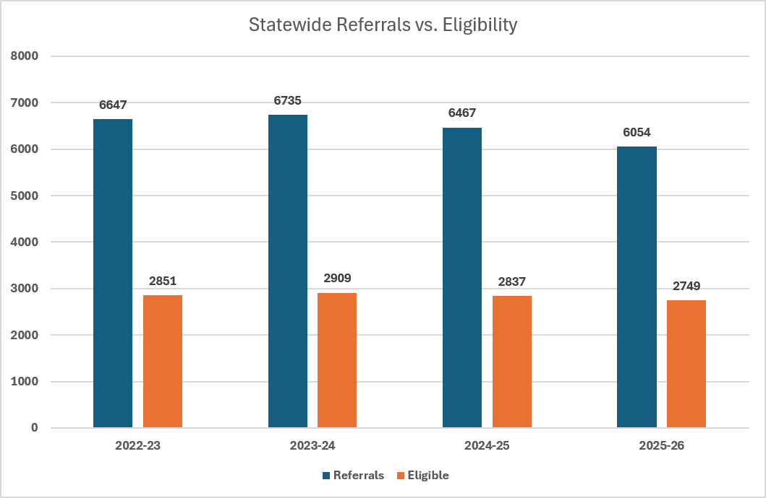
Child Find
Notes:
Cole
****Parent Questions*****
How many services they receive on average monthly basis - do you feel it’s enough to help support your family and child; do you think your child is making progress?
Where does your child receive the majority of his/her IFSP services? If at childcare, do you receive home visits too? How did the IFSP team decide where services will occur, i.e. who was involved in making the decision? What was the reason for choosing the location where the services occur?
If most of your child’s IFSP services are at childcare, do you know when the service is happening and what IFSP outcome[s] was addressed? If yes, how is this communicated with you? If no, how do you learn what is happening at childcare?

Slide 70
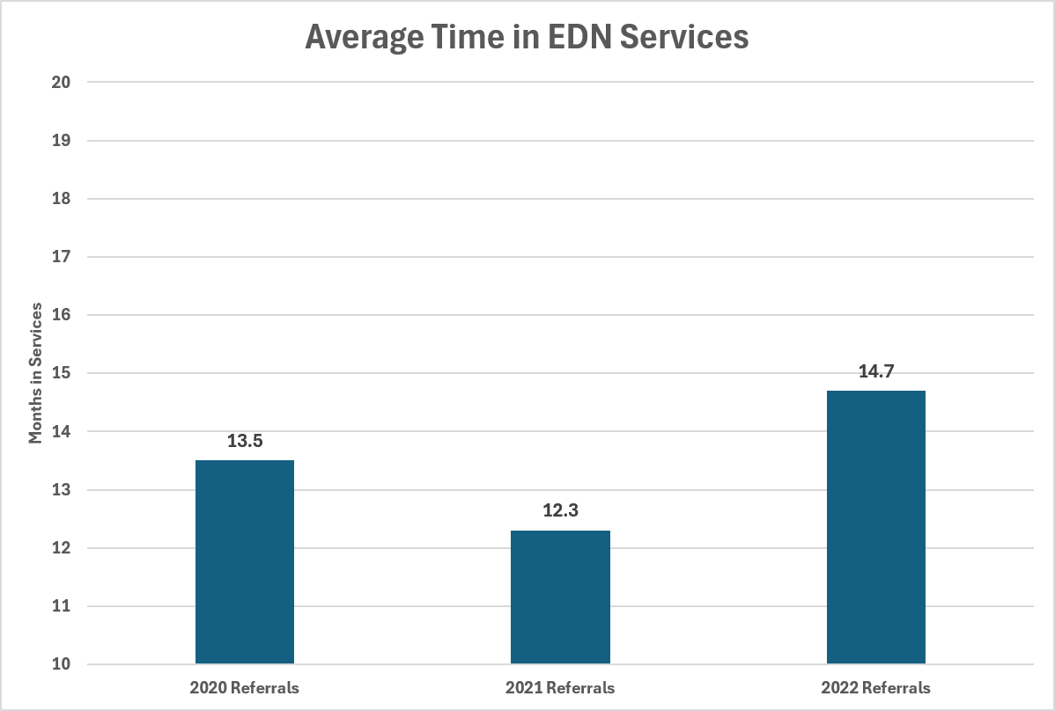
Child Find
Notes:
Cole
****Parent Questions*****
How many services they receive on average monthly basis - do you feel it’s enough to help support your family and child; do you think your child is making progress?
Where does your child receive the majority of his/her IFSP services? If at childcare, do you receive home visits too? How did the IFSP team decide where services will occur, i.e. who was involved in making the decision? What was the reason for choosing the location where the services occur?
If most of your child’s IFSP services are at childcare, do you know when the service is happening and what IFSP outcome[s] was addressed? If yes, how is this communicated with you? If no, how do you learn what is happening at childcare?

Slide 71
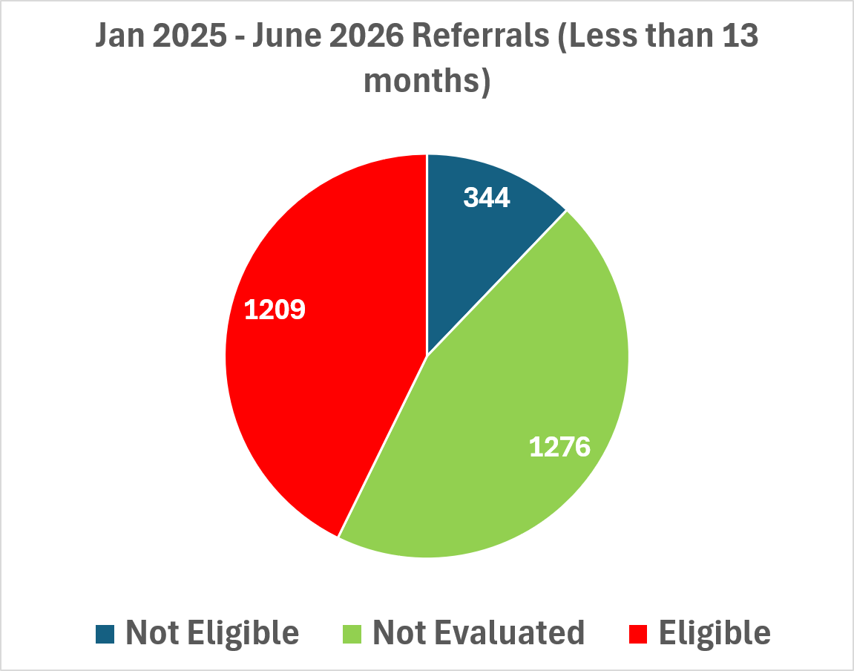
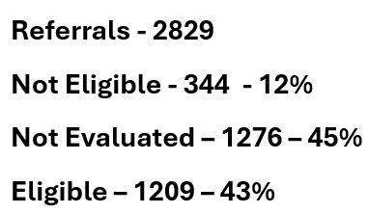
Notes:
Cole
Not Elig is no’s (127) and not evaled (586)

Slide 72
Discussion
How can we increase evaluation percentages for the B-1 population?
For families: When concerns about your child's development were first identified, was a "wait and see" approach discussed? What role, if any, did that approach play in your family's journey to EDN?
Are EDN teams effectively promoting the benefits of EDN services to families?

Slide 73
Settings/Location Data
2 visits per month happening in a child care/other natural environment (not the home)
Notes:
Cole

Slide 74
Impact on EI Child Outcomes
Statewide Average EDN Experience
Eligible for EDN - 19 months old
Getting ~13 months of EDN services
11-13 EI visits lasting 30 minutes
  ⅓ of these visits are in child care (no parents)
Given this data, is it reasonable for PRTs to meet targets?
Notes:
Cole
Maybe only 3 home visits or 1.5 hours of EDN time.

Slide 75

Differentiated Monitoring
and Support
DMS 2.0

Slide 76
Differentiated Monitoring and Support
DMS 2.0
Monitoring of a state’s early intervention system conducted by the US Department of Education, Office of Special Education Programs (OSEP) under IDEA Parts B and C.
Nebraska’s DMS visit was held October 21-24, 2024.
Nebraska received the Part C Differentiated Monitoring and Support (DMS) Findings Letter issued by the U.S. Department of Education’s Office of Special Education Programs (OSEP) on April 16, 2026.
Notes:
Cole

Slide 77
DMS 2.0 Finding
Individualized Family Service Plan
The content of the IFSP must include information about the child’s status, including a statement of the infant or toddler with a disability’s present levels of development based on the information from that child’s evaluation and assessments.
OSEP claims that Nebraska uses the child’s chronological age to describe the present levels of development rather than the child’s evaluation and assessment results.

Slide 78
DMS 2.0 Finding - Nebraska’s Response
Individualized Family Service Plan Form and Instruction Updates
Child’s Present Levels of Development section now requires teams to document the child’s Current Abilities and Developmental Functioning, including a brief narrative describing the child’s functional performance in each developmental area. (What the child can do, what is difficult for the child, and how the child’s skills affect their participation in daily routines)
Date of Evaluation is renamed “Date of Child Assessment”
Column displaying the child’s chronological age is removed

Slide 79
DMS 2.0 Finding
2. Dispute Resolution Process and Due Process Hearing Procedures
The State does not have written procedures to ensure that required timelines are met for convening a resolution meeting, a final decision is reached in the hearing, and a copy of the decision is mailed to each of the parties.
Corrective Action:
•By July 15th – submit revised written procedures

Slide 80
DMS 2.0 Findings- Fiscal
4. Maintenance of Effort Requirements
The State must have a methodology to track and calculate the total amount of State and local funds budgeted for expenditures, and actually expended, in a fiscal year for early intervention services.
5. System of Payment Policy
The State does not monitor to ensure local program compliance with providing notice and receiving parental consent for the use of Medicaid to pay for early intervention services.
6. Unallowable Use of Funds
The use of IDEA Part B funds to pay for early intervention services for infants and toddlers with disabilities age birth to 3 is not allowed.

Slide 81
DMS 2.0 Findings- Fiscal
Corrective Action:
By July 15th:
Submit policies describing the State’s methodology to track all State and local public funding sources to enable it to ensure compliance with the IDEA Part C MOE requirements.
Submit revised System of Payment Policy consistent with IDEA.
Provide specific written assurances that NE will immediately cease the use of IDEA Part B funds for early intervention services and eliminate IDEA Part B funds as a payor source within the State’s IDEA Part C system.

Slide 82
DMS 2.0 Findings - Fiscal
Nebraska exercised its right to request reconsideration of the specific conditions imposed in the DMS Findings Letter. The State submitted a formal request outlining its legal, fiscal, and programmatic position.
OSEP responded to Nebraska’s Request for Reconsideration on June 12, 2026:
  “OSEP has concluded the review of your request for reconsideration and your request is denied”.

Slide 83
DMS 2.0 Findings - Fiscal
OSEP is amending the timelines, and NDE may propose alternative timelines for the required actions for submission of policies related to Maintenance of Effort and System of Payment in the corrective action plan due to OSEP by September 30, 2026. This flexibility allows NDE the opportunity to develop a corrective action plan, including proposed reasonable timelines, that systemically addresses all the fiscal findings.
The specific assurances on the IDEA Part B and Part C grant applications and the specific condition on the Part B grant award will remain for subsequent IDEA grant awards until NDE demonstrates that it has come into compliance.

Slide 84
DMS 2.0 Findings
Submission of Corrective Action Plan on Sept. 30, 2026:
a. The additional actions Nebraska will take to discontinue the use of
IDEA Part B funds to provide early intervention services to infants and toddlers.
b. Revisions of regulations, policies, and procedures to come into compliance with IDEA requirements regarding the appropriate use of IDEA Part B funds (includes Maintenance of Effort and System of Payments policies).
c. A plan for how the State will fund early intervention.
d. A plan for how the State will provide technical assistance, training, and/or support to LEAs on the appropriate use of IDEA Part B subgrants.

Slide 85

Questions?
Notes:
Cole

Slide 86
Thank You!
Jessica Anthony jessica.anthony@nebraska.gov
Amy Bunnell amy.bunnell@nebraska.gov
Cole Johnson cole.johnson@nebraska.gov
Notes:
Cole

