Slide 1
Leading Through change and conflict
Greg Abell
Sound Options Group, LLC
grega@somtg.com
www.soundoptionsgroup.com

Slide 2
What is the role of Leadership in navigating Change and Engaging Conflict?
What do I need to understand about Change and Transition if I am to lead effectively?
How do I do I mobilize people to engage challenging and difficult conversations?
What is the situation calling me to be? What is the situation calling me to do?

Slide 3
A Framework

Slide 4
Engaging “At Integrity” Choosing to Align Action with Commitments

Slide 5
Two Guiding Questions
Being:
What is this situation calling me to Be as I engage?
Who am I committed to Be in this situation?
Doing:
What will I choose to Do in this situation that will keep me in alignment with my commitment(s)?
and

Slide 6
Leadership
Leadership is not a rank or position. It is a choice – a choice to look after the person to the left of us and the person to the right of us. – Simon Sinek
For people to follow someone willingly, the majority of constituents believe the leader must be “Honest, Forward Looking, Inspiring, Competent. - Kouzes and Posner
“I define a leader as anyone who takes responsibility for finding the potential in people and processes and who has the courage to develop that potential.” Brene Brown
Becoming a leader is synonymous with being yourself. It is precisely that simple, and it’s also that difficult. . . First and foremost, find out what it is you’re about, and be that. - Warren Bennis
Mobilizing people to tackle tough problems – Ronald Heifetz
Notes:
I want to spend our time exploring your role as leaders in your context.
Let’s look at perspectives on leadership from those who speak to this challenge
Choice – anyone has the potential to function as a leader.
Your focus is on the people doing the work.
ECSEL example
Attributes / Character – TRUST. It’s about who you are, how you show up. BOTH DOING AND BEING Not about having all the answers
In the book, Primal Leadership: Realizing the Power of Emotional Intelligence, the authors differentiate between Dissonant and Resonant Leadership. What do you experience when when these leaders show up?
Committed to the success of others - -
“Exemplary leaders are interested more in others’ success than in their own. Their greatest achievements are the triumphs of those they serve. Knowing they have made a difference in others’ lives is what motivates their own, giving leaders the strength to endure hardships, and inevitable sacrifices required to achieve great things. Leaders who see their role as serving others leave the most lasting legacies.” A Leaders Legacy, Kouzes and Posner.
Leader as Coach
It’s an inside and an outside job
And it is an ongoing process of learning and growth
Let Your Life Speak – Parker Palmer
Mobilizing people to do work
This tend to be my go-to model

Slide 7
Authority and Leadership
Authority
“Conferred power to perform a service”
Leadership
“Mobilizing people to tackle tough problems”
Leadership Without Easy Answers Ronald Heifetz

Slide 8
Technical & Adaptive Work
Technical work
“Technical problems are those that, in some sense, we already know how to respond to them.”
Adaptive work
“The problem definition is not clear-cut, and technical fixes are not available. Learning is required to both define problems and implement solutions.”
Leadership Without Easy Answers Ronald Heifetz

Slide 9
Situational Styles
Situation | Problem definition | Solution/ implementation | Primary responsibility | Type of work
Type l | Clear | Clear | Authority | Technical
Type ll | Clear | Requires Learning | Authority & Team | Technical & Adaptive
Type lll | Requires Learning | Requires Learning | Team & Leader | Adaptive

Slide 10
WHO or what HAS informed and influenced YOUR UNDERSTANDING OF LEADERSHIP? HOW? What is your commitment to Leadership?

Slide 11
Managing Transitions Making the Most of Change
William and Susan BridgesWillind Susan Bridges

Slide 12
Differentiating Change from Transition
Change is not the same as Transition
Change is situational
Transition is the psychological process people go through to come to terms with the new situation.
Change is external, Transition is internal
Unless Transition occurs, Change will not work
Managing Transitions: Making the Most of Change
William and Susan Bridges

Slide 13
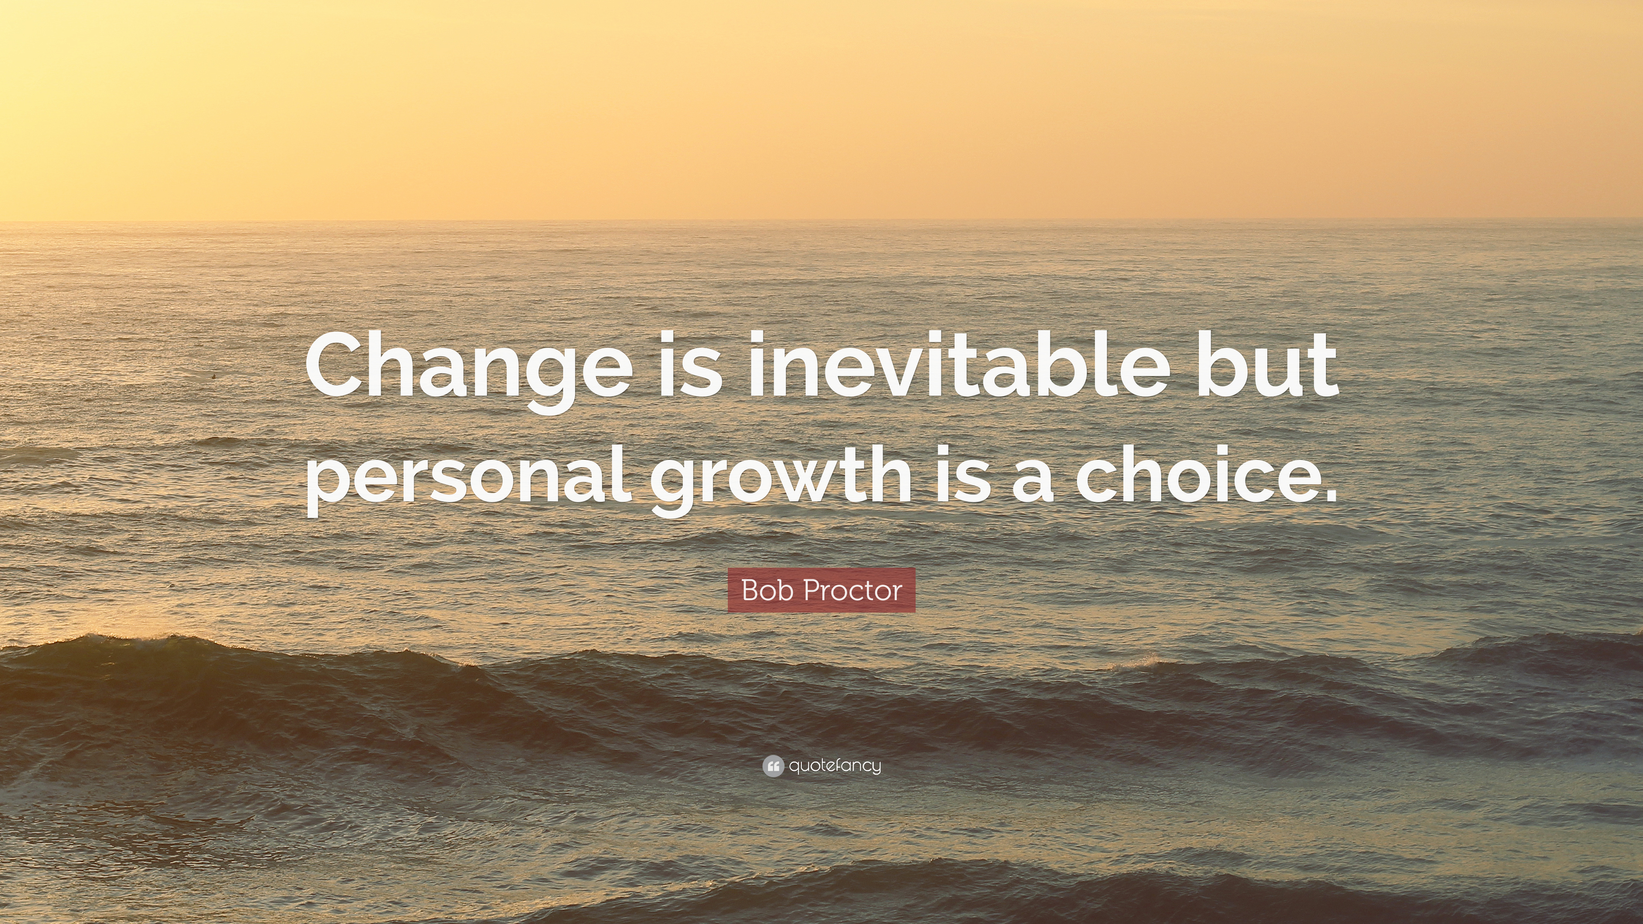
When we talk about change, we naturally focus on the outcome the change will produce.
Transition is different. The starting point for transition is not the outcome but the ending you will have to make to leave the old situation behind.

Slide 14
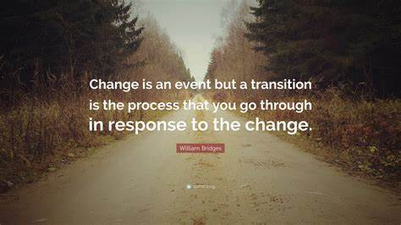
Ending / Letting Go - The Neutral Zone - New Beginnings

Slide 15
As you reflect on your experience with change, what from this model of Change and Transition stands out to you as most significant? Within your experience, when and how have you observed the elements of this process? Personally? Professionally?

Slide 16
Immunity to Change How to Overcome It and Unlock the Potential in Yourself and Your Organization
Robert Kegan
Lisa Laskow Lahey

Slide 17
The Immunity X-Ray
Commitment (Improvement Goal) | Doing/Not Doing Instead | Hidden Competing Commitments | Big Assumptions
Worry Box:

Slide 18
The Immunity X-Ray
Commitment (Improvement Goal)
First Column – Visible Commitment
The person to whom you report
Peers
At least one direct report
Criteria:
Is it important to me? Do I want to accomplish this? Is it urgent?
Is it important to someone else?
Does accomplishment of the goal primarily implicate me?
Is it stated affirmatively? Reframe if necessary.

Slide 19
The Immunity X-Ray
Commitment (Improvement Goal) | Doing/Not Doing Instead
Second Column: What am I doing or not doing instead?
Describe specific behaviors – What do you do or fail to do.
More items – greater diagnostic power
Only list items that work against your column 1 goal
Do not try to justify or rationalize

Slide 20
The Immunity X-Ray
Commitment (Improvement Goal) | Doing/Not Doing Instead | Hidden Competing Commitments
Step 1: The “Worry Box” (biggest worry, discomfort, outright fear)
If I imagine myself trying to do the opposite of this, what is the most uncomfortable, or worrisome, or outright scary feeling that comes up for me?
Identify an actual “loathsome feelings.” You need to get to a place where you feel yourself at risk in some way; where you are unprotected from something that feels dangerous to you.
Step 2: Generating Possible Competing Commitments
Is it a commitment to self-protection?
Does the commitment make the behaviors in column 2 perfectly sensible?
Can you see how changing the behavior in column 2 is insufficient?
Can see how the tension in two directions keeps you stuck?
Do you begin to see a coherent whole?

Slide 21
The Immunity X-Ray
Commitment (Improvement Goal) | Doing/Not Doing Instead | Hidden Competing Commitments | Big Assumptions
Fourth Column – Big Assumptions
Some of the “Big Assumptions” you may regard as true.
It shows how the assumption makes the third column commitment inevitable

Slide 22
As you reflect on your experience with change, what from this model of Change and Transition stands out to you as most significant? Within your experience, when and how have you observed the elements of this process? Personally? Professionally?

Slide 23
Where did I learn about conflict?

Slide 24
Activity
Identify 1-2 events in your life that you believe shaped the way in which you currently relate to conflict.
Why were they significant?
What did you learn about conflict? About yourself?
How do these experiences inform how you show up in conflict today?
Share in small groups.

Slide 25
Ingredients of a Conflict
Two or more people
interact
and perceive
incompatible difference or threats
Resources
Needs
Values
behave and respond
Choice Point!
to escalate or deescalate the conflict

Slide 26
Six faces of conflict
Low-impact Conflict
Latent Conflict
Transient Conflict
Representative Conflict
Stubborn Conflict
Enduring Conflict

Slide 27
Five Conflict-Handling Styles
Assertive
Competing
Collaborating
Compromising
ASSERTIVENESS
Avoiding
Accommodating
Unassertive
Uncooperative
Cooperative
COOPERATIVENESS

Slide 28
What is your current Strategy for Conflict?
What do you believe to be your preferred or dominant conflict style?
What about a situation might have you shift away from your preferred style?
When will you you choose to engage conflict? What about a situation or context might invite your participation? What does engagement look like?
When will you choose to avoid conflict? What about a situation might inhibit your engagement? What does avoidance look like?

Slide 29
Conversational Structures
Changing the structure of the conversation can change the nature of the relationship.

Slide 30
Conversational Structure
Every conversation has a structure that invites certain kinds of responses and inhibits other kinds of responses.
We approach most difficult situations prepared to tell the other person something that is important to us.
Our preparation involves how we can tell the other person in a way that will be effective.
Choose your conversation or it will choose you.

Slide 31
What makes some conversations more difficult?
Perception of difference or threat
Involve issues of significance
Strong emotions
Pivotal to the relationship
Characterized by “approach/avoidance”

Slide 32
Two Types of Stances
TELLING
Judgment
Hubris
Pretense
Dismiss
LEARNING
Curiosity
Humble
Presence
Acknowledge

Slide 33
Conversation Structure & Choices
Suspend
Reflective Dialogue
Generative Dialogue
Choice Point
Conversation
Deliberation
Skillful Conversation
Dialectic
Defend
Choice Point
Controlled Discussion
Debate
Dialogue and the Art of Thinking Together
William Issacs

Slide 34
“Individually intelligent people can collectively make stupid decisions from shallow pools of understanding.”
“One measure of a group’s intelligence is the depth of its shared pool of understanding.”

Slide 35
Relationships Within the School House Roland S. Barth
One incontrovertible finding emerges from my career spent working in and around schools: The nature of relationships among the adults within a school has a greater influence on the character and quality of that school and on student accomplishments than anything else.

Slide 36
Leading Through Conflict
A Framework

Slide 37
Seeing the Issues, Positions, and Interests

Slide 38
Action
P1
OPTIONS
P2
ISSUE
I1
I2
COMMON GROUND

Slide 39
Partner - Engaging in conflict as a participant
Facilitator - Serving others in the engagement of conflict
Arbiter - Imposing resolution to the conflict in service of shared purpose

Slide 40
Preparing to Engage
Convening the Conversation
Increasing Shared Understanding
Moving from Inquiry to Action

Slide 41
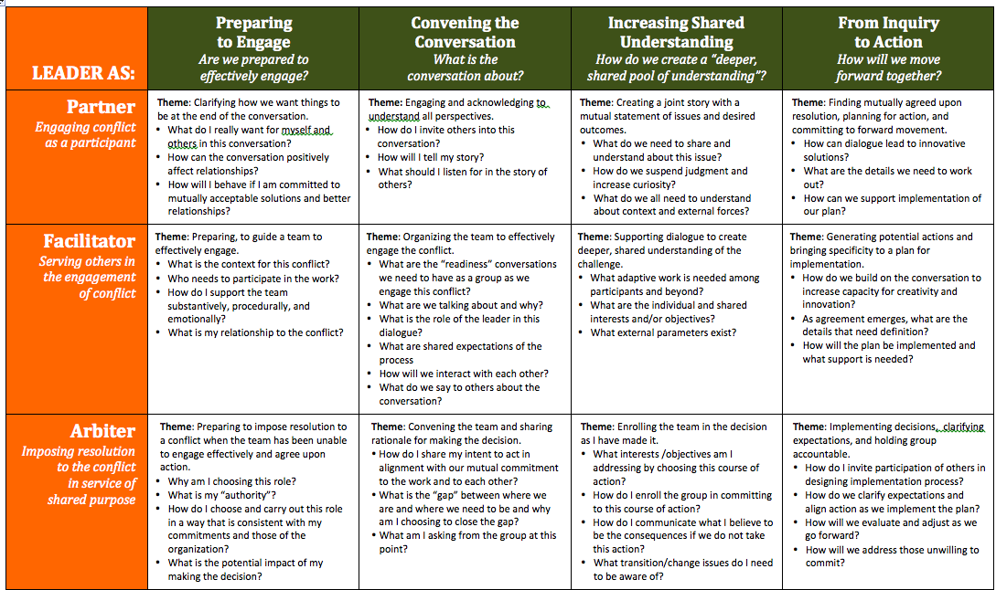
Notes:
Greg talk about themes and prompts

Slide 42
Phase One: Preparing to Engage
Are we prepared to effectively engage in this challenge?

Slide 43
Phase one Objectives
Become
Become intentional as to your role in leading through conflict.
Identify
Identify a strategic approach for preparing to effectively lead in the engagement of conflict.
Develop
Develop strategies for preparing others to effectively engage in conflict.

Slide 44
Elements of Satisfaction
Substantive
Procedural
Relational

Slide 45
Special Considerations for roles leaders fill in conflict
Partner – How do I structure a conversation among “equals” and address potential power imbalances?
Facilitator – How do I balance my role as facilitator with my role as participant when I have a stake in the outcome?
Arbiter – How do I prepare myself to lead courageously in service of mutual purpose?

Slide 46
Phase Two: Convening the Conversation
What is the conversation really about?
How can we successfully have this conversation?

Slide 47
Notes:
Greg talk about themes and prompts

Slide 48
Phase Two Objectives
Create
Create a “safe” space for dialogue
Establish
Establish a commitment to Mutual Purpose
Clarify and establish
Clarify and establish Shared Expectations.

Slide 49
Start with a dialogue about the conversation
The leader must be completely transparent
Others must feel they can contribute to build shared understanding
The conversation about the issue(s) can start once the group reaches consensus on how to have the conversation
Balancing Task with Maintennance

Slide 50
Internal Structures
External Connections
Operationalization of Core Values
Group Behavioral Norms
Understanding Roles and Responsibilities
Clarity of Purpose
Common Language

Slide 51
Phase Three: Increasing Shared Understanding
How do we create a “deeper, shared pool of understanding”?

Slide 52
Notes:
Greg talk about themes and prompts

Slide 53
Phase Three Objectives
Supporting
Supporting dialogue to create deeper, shared understanding of the challenge
Creating
Creating a shared story with a mutual statement of issues and desired outcomes
Clarifying
Clarifying my decision and enrolling the team in implementation that follows.

Slide 54
The Power of Questions
What we ask, how we ask it, the spirit with which we ask, all invite certain responses and discourage others.
The very act of asking questions influences people. Acts of asking and answering alter experiences and generate experiences.
Questions have the power to shape meanings and restrict or expand possibilities for action.

Slide 55
Intentional Inquiry
Is intentional and purposeful
Is born of genuine curiosity.
Causes both the inquirer and the responder to “ponder.”
Broadens the range and opportunity for response.
Creates openings rather than closings.

Slide 56
Crafting Intentional Questions
What work do I want this question to do?
Broadening Questions
Clarifying Questions
Explaining Question
Exploring Questions
Challenging Questions
Brainstorming Questions
Consequential Questions
Is this question likely to stimulate fresh thinking?
Do I have an answer in mind?
Are my own assumptions imbedded in this question?

Slide 57
Special consideration in each role
Partner – how do I effectively balance Advocacy with Inquiry?
Facilitator – how do I facilitate a conversation in service of adaptive work?
Arbiter – How open am I to input at this point in my decision-making process?

Slide 58
Phase Four: Moving from Inquiry to Action
How will we move forward together?

Slide 59
Skills and Strategies
Synthesizing and giving back (a balcony view)
Promoting creative options
Dealing with competing values and making choices
Reality testing
Creating a detailed plan

Slide 60
Special consideration in each role
Partner – how will forward movement continue in the work and in the relationships beyond the conversation?
Facilitator – how will the outcome of dialogue be communicated beyond the participants to increase engagement, creativity and innovation?
Arbiter – how will others be engaged in implementation and accountability?

